Slide 1
Mass ParentCorps
January 27, 2026

Slide 2

Agenda for Today
Highlights from the Past Few Months
What we learned from the Parent Focus Groups
Our Strategy Moving Forward
Timeline and Next Steps

Slide 3


Overview
Frame our Vision…
Where we are now?
Where we might go?
Stakeholders
+
Parent Leaders
How to get started:
Operating model for pilot
Governance and key roles
Funding
…And then help identify
what we need to get there

Slide 4
Highlights from Stakeholders
Stakeholder Meetings: EEC, Boston Opportunity Agenda, DESE, NY Metro Center, MSPCC, Massachusetts Association of Community Colleges, The Boston Foundation
Strong commitment to parent leadership development
Parent leaders’ contributions are highly valued
Shared agreement on structured leadership, educational and career pathways
Substantial work already underway can be built upon
Start simple – 1 small cohort, 1 community college, not for credit, nest within existing enterprise
Notes:
Funding
Qin Li to support work
Magda to support work

Slide 5

What We’re Learning from Parents
Parent focus groups, referred by five pioneering parent leadership leaders, offer a meaningfully representative snapshot of parent leadership in its most advanced form
Many strengths and successes were evident, reflecting the strong work of sponsoring CBOs
In addition, a number of gaps, barriers, and opportunities for improvement were identified

Slide 6
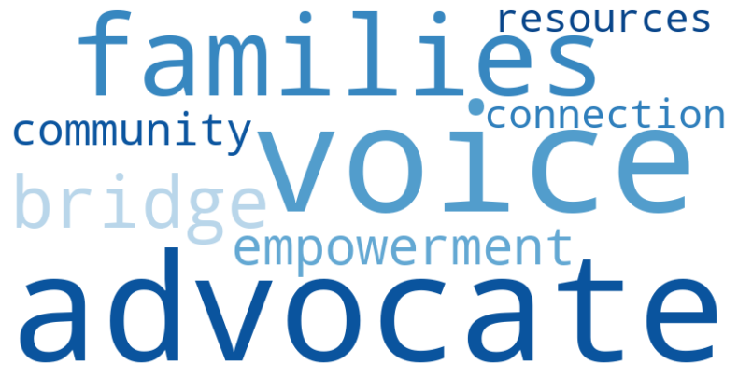
How did they describe their roles
Clearly defined but diverse parent leadership roles, common themes:
Advisory Board Member
Parent Ambassador
Family Advocate
Playgroup Facilitator
Community Organizer
Parent Partner
Health Care Navigator
Family Engagement Coordinator

Slide 7
How Parent Leaders Described their Skills and Barriers
Skills Learned in Current Roles
Effective Communication
Public Speaking
Advocacy
Leadership Development
Confidence Speaking Up
Facilitation & Group Mangagment
Relationship Building
Understanding and Navigating systems
Problem Solving
Skills Missing/First Years
Confidence
Public Speaking
Advocacy
Leadership
Understanding System & Policies
Time Management
Barriers
Language Barriers
Lack of Time (Balancing Work and Family Responsibilities)
Inconsistent Communication
Limited Financial Compensation

Slide 8
Areas for Improvement
Inconsistent pathways for growth beyond initial leadership roles
Limited access to credentials, compensation, or career-aligned opportunities
Variation across CBOs in structure, support, and sustainability
Strong desire for clearer pathways and shared standards across organizations while accommodating different needs

Slide 9
Key Takeaways
Strong excitement for a statewide parent leadership model
Interest in shared learning, credentials, and workforce alignment
Opportunities to strengthen—not replace—existing CBO-led leadership models
Access to resources
Equity & opportunity
Recognition of parent leadership
Notes:
Pause

Slide 10
Strategy Moving Forward
Parent leadership courses with community-based practicum opportunities
Co-design with participating CBOs, parent leaders and community colleges
Small, intentional pilot cohort with 20-25 emerging parent leaders
Flexible structure with room for learning and iteration
Clear evaluation plan

Slide 11
Next Steps for CBOs
Participate in Steering Committee – March – April
3-4 meetings
$5000 stipends will be distributed by the end of February ($1000 stipend for parent leader)
Contact Don and Magda if want to be part of the pilot design working group
Nominate emerging parent leaders to be part of the pilot

Slide 12
Timeline
February:
Steering Committee/Theory of Change Planning Meeting
Pilot Working Group Starts
March
Steering Committee 1st and 2nd Meeting
Website is launch
Pilot Working Group Meetings
Further fundraising for Pilot
April
Steering Committee 3rd Meeting
Pilot Working Group Meetings
Parent Leadership Advisory Starts
Fundraising for Pilot
May
Pilot Working Group Meetings

